Slide 1



Syntax-Directed Translation

Slide 2
Syntax-Directed Translation
There are two notations for associating semantic rules with productions, syntax-directed definitions and translation schemes.
Syntax-directed definitions are high-level specifications for translations. They hide many implementation details and free the user from having to specify explicitly the order in which translation take place.
Translation schemes indicate the order in which semantic rules are to be evaluated, so they allow some implementation details to be shown.

Slide 3
Syntax-Directed Translation
Conceptually, with both syntax-directed definition and translation schemes, we parse the input token stream, build the parse tree, and then traverse the tree as needed to evaluate the semantic rules at the parse-tree nodes.
Evaluation of the semantic rules may generate code, save information in a symbol, issue error messages, or perform any other activities. The translation of the token stream is the result obtained by evaluating the semantic rules.
Input string
Parse Tree
Dependency graph
Evaluation order for semantic rules

Slide 4
Syntax-Directed Translation
An implementation does not have to follow the outline literally. Special cases of syntax directed definition can be implemented in the single pass by evaluating semantic rule during passing, without explicitly constructing a parse tree or a graph showing dependencies between attributes. Since single pass implementation is important for compiler time efficiency. One important subclass, called the L-attributed definition encompasses virtually all translations that can be performed without explicit construction of a parse tree.

Slide 5
Syntax-Directed Definitions
Syntax directed definition is a generalization of a context free grammar in which each grammar symbol has an associated set of attributes partitioned into two subsets called the synthesized and inherited attributes of that grammar symbol. If you think of a node for a grammar symbol in a parse tree as a record with fields for holding information, then an attribute corresponds to the name of a field.

Slide 6
Syntax-Directed Definitions
An attribute can represent anything we choose: a string, a number, a type, a memory location or whatever. The value of an attribute at the parse-tree node is defined by the semantic rule associated with the production used at the node. The value of the synthesized attribute at the node is computed from the value of attributes at the children of that node in the parse tree; the value of an inherited attributes is computed from the values of attributes at the sibling and the parent of the node.

Slide 7
Syntax-Directed Definitions
Semantic rules set up dependencies between attribute that will be represented by a graph. From the dependency graph, we derive and evaluation order for the semantic rules. Evaluation of semantic rules define the value of attribute the nodes the parse tree for the input string. A semantic rule may also have side effect example printing a value or updating a global variable. Of course an implementation need not explicitly construct a parse tree or a dependency graph; it just has to be produce the same output for each input string.

Slide 8
Syntax-Directed Definitions
A parse tree showing the values of attributes at each node is called and an annotated. The process of computing the attribute value at the node is called annotating or decorating the parse tree.

Slide 9
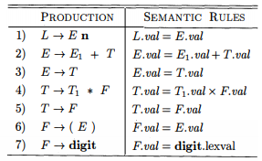
SDD Example
Example 5.1 : Grammar for arithmetic expressions with operators + and *. It evaluates expressions terminated by an endmarker n. In the SDD, each of the nonterminals has a single synthesized attribute, called val.

Slide 10
Synthesized Attributes
A synthesized attribute for a nonterminal A at a parse-tree node N is defined by a semantic rule associated with the production at N. Note that the production must have A as its head. A synthesized attribute at node N is defined only in terms of attribute values at the children of N and at N itself.
A synthesized attribute are used extensively in practice. A syntax directed definition that uses synthesized attributes exclusively is said to be an S attribute definition. A parse tree for an S attribute definitions can always be annotated by evaluating the semantic rule for the attributes at each node bottom up from the leaves to the root.

Slide 11
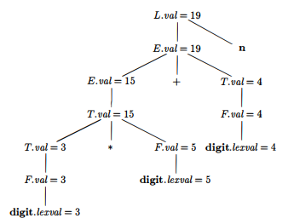
Synthesized Attributes
The S-attributed definition specifies a desk calculator that reads an input line containing an arithmetic expression involving digits, parentheses, the operators + and *, followed by a newline character n and prints the value of the expression.

Slide 12
Inherited Attributes
An inherited attribute is one whose value at the node in a pass tree is defined in terms of attributes at the parent or/and sibling of that node. Inherited attributes are convenient for expressing the dependence of a programming language construct on the context in which it appears.
For example we can use an inherited attributes to keep track of whether an identifier appears on the left or right side of an assignment in order to decide whether the address of the value of an identifier is needed.

Slide 13
Inherited Attributes
An inherited attribute for a nonterminal B at a parse-tree node N is defined by a semantic rule associated with the production at the parent of N. Note that the production must have B as a symbol in its body. An inherited attribute at node N is defined only in terms of attribute values at N's parent, N itself, and N's siblings.

Slide 14
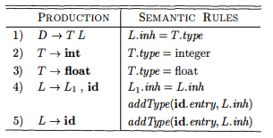
Inherited Attributes
The SDD takes a simple declaration D consisting of a basic type T followed by a list L of identifiers. T can be int or float. For each identifier on the list, the type is entered into the symbol-table entry for the identifier.

Slide 15
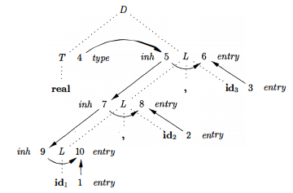
Inherited Attributes
A dependency graph for the input string float id1 , id2 , id3 Numbers 1 through 10 represent the nodes of the dependency graph. Nodes 1, 2, and 3 represent the attribute entry associated with each of the leaves labeled id. Nodes 6, 8, and 10 are the dummy attributes that represent the application of the function addType to a type and one of these entry values.

Slide 16
Dependency Graph
If an attribute b at a node in a pass tree depends on an attribute C then the semantic rule for be at that note must be evaluated after the semantic rule that defines c.
The interdependencies among the inherited and synthesized attribute at the node in the parse tree can be depicted by a directed graph called a dependency graph.

Slide 17
Evaluating Semantic Rules
Several methods have been proposed for evaluating semantic rules:
Parse tree methods. At compile time this method obtain an evaluation order from the topological sort of the dependency graph constructed from the past tree from each input. This methods will fail to find an evaluation order only if the dependency graph for the particular purpose tree under the consideration has a cycle.

Slide 18
Evaluating Semantic Rules
Several methods have been proposed for evaluating semantic rules:
Rule based methods: At compiler construction time the semantic rule associated with production are analyzed, either by hand or by a specialized tool. For each production, the order in which the attribute associated with the production are evaluated is pre-determined at compiler construction time.

Slide 19
Evaluating Semantic Rules
Several methods have been proposed for evaluating semantic rules:
Oblivious method: An evaluation order is chosen without considering the semantic rules. For example, if translation takes place during passing then the order of evaluation is force by the passing method independent of the semantic rules. An oblivious evaluation order restricts the class of syntax directed definition that can be implemented.

Slide 20
Evaluating Semantic Rules
Rule based and oblivious method need not explicitly construct the dependency graph at the compile time so they can be more efficient in their use of compile time and space.
Syntax directed definition is said to be circular if the dependency graph for some past regenerated by its grammar has a cycle.

Slide 21
Application of SDD
The main application of SDD is the construction of syntax trees. Since some compilers use syntax trees as an intermediate representation, a common form of SDD turns its input string into a tree. To complete the translation to intermediate code, the compiler may then walk the syntax tree, using another set of rules that are in effect an SDD on the syntax tree rather than the parse tree.

Slide 22
Construction of Syntax Tree
A syntax-tree node representing an expression El + E2 has label + and two children representing the sub expressions El and E2. We shall implement the nodes of a syntax tree by objects with a suitable number of fields. Each object will have an op field that is the label of the node. The objects will have additional fields as follows:
• If the node is a leaf, an additional field holds the lexical value for the leaf. A constructor function Leaf( op, val) creates a leaf object.

Slide 23
Construction of Syntax Tree
Alternatively, if nodes are viewed as records, then Leaf returns a pointer to a new record for a leaf.
If the node is an interior node, there are as many additional fields as the node has children in the syntax tree. A constructor function Node takes two or more arguments: Node(op, Cl , C2, ... , Ck ) creates an object with first field op and k additional fields for the k children Cl , ... , Ck·

Slide 24
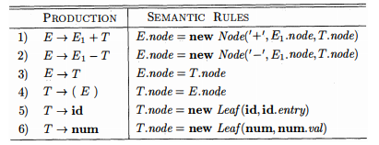
A Syntax-Directed Definition for Constructing syntax Trees
The S-attributed definition in Fig. 5.10 constructs syntax trees for a simple expression grammar involving only the binary operators + and -. As usual, these operators are at the same precedence level and are jointly left associative. All nonterminals have one synthesized attribute node, which represents a node of the syntax tree.

Slide 25
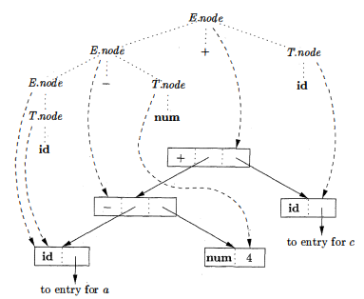
L Attributed Definition
The L-attributed definition in performs the same translation as the S-attributed definition in Figure. The attributes for the grammar symbols E, T, id, and num

Slide 26
L Attributed Definition
Steps in the construction of the syntax tree for
a – 4 + c
PI == new Leaf(id, entry-a) ;
P2 == new Leaf (num, 4);
P3 == new Node(' -', Pl ,P2);
P4 == new Leaf(id, entry-c) ;
P5 == new Node(' +', P3, P4);

Slide 27
The Structure of a Type
Inherited attributes are useful when the structure of the parse tree differs from the abstract syntax of the input; attributes can then be used to carry information from one part of the parse tree to another. The next example shows how a mismatch in structure can be due to the design of the language, and not due to constraints imposed by the parsIng method.

Slide 28

The Structure of a Type
In C, the type int [2][3] can be read as, "array of 2 arrays of 3 integers." The corresponding type expression array(2, array(3, integer)) is represented by the tree. The operator array takes two parameters, a number and a type. If types are represented by trees, then this operator returns a tree node labeled array with two children for a number and a type.

Slide 29
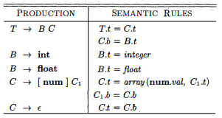
The Structure of a Type
With the SDD, nonterminal T generates either a basic type or an array type. Nonterminal B generates one of the basic types int and float. T generates a basic type when T derives Be and C derives t.
Otherwise, C generates array components consisting of a sequence of integers; each integer surrounded by brackets.

Slide 30
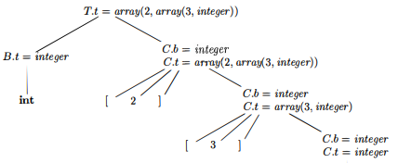
The Structure of a Type
Syntax-directed translation of array types

Slide 31
Syntax-Directed Translation Schemes
A syntax-directed translation scheme (SDT) is a context free grammar with program fragments embedded within production bodies. The program fragments are called semantic actions and can appear at any position within a production body. By convention, we place curly braces around actions; if braces are needed as grammar symbols, then we quote them. Any SDT can be implemented by first building a parse tree and then performing the actions in a left-to-right depth-first order; that is, during a preorder traversal.

Slide 32
Syntax-Directed Translation Schemes
By far the simplest SDD implementation occurs when we can parse the grammar bottom-up and the SDD is S-attributed. In that case, we can construct an SDT in which each action is placed at the end of the production and is executed along with the reduction of the body to the head of that production. SDT's with all actions at the right ends of the production bodies are called postfix SDT's.

Slide 33
Postfix Translation Schemes
Typically, SDT's are implemented during parsing, without building a parse tree. In this section, we focus on the use of SDT's to implement two important classes of SDD's:
The underlying grammar is LR-parsable, and the SDD is S-attributed.
The underlying grammar is LL-parsable, and the SDD is L-attributed.

Slide 34
Postfix Translation Schemes
The postfix SDT implements the desk calculator SDD, with one change: the action for the first production prints a value. The remaining actions are exact counterparts of the semantic rules. Since the underlying grammar is LR, and the SDD is S-attributed, these actions can be correctly performed along with the reduction steps of the parser.
L -t En { print(E.val) ; }
E -t El + T { E.val = E1 .val + T.val; }
E -t T { E.val = T.val; }
T -t Tl * F { T.val = T1 .val x F.val; }
T -t F { T.val = F.val; }
F -t (E) { F.val = E.val; }
F -t digit { F.val = digit.lexval; }
Postfix SDT implementing the desk calculator.

Slide 35
Parser-Stack Implementation of Postfix SDT’s
Postfix SDT's can be implemented during LR parsing by executing the actions when reductions occur. The attribute(s) of each grammar symbol can be put on the stack in a place where they can be found during the reduction. The best plan is to place the attributes along with the grammar symbols (or the LR states that represent these symbols) in records on the stack itself.
The parser stack contains records with a field for a grammar symbol (or parser state) and, below it, a field for an attribute.

Slide 36
Parser-Stack Implementation of Postfix SDT’s
The three grammar symbols X Y Z are on top of the stack; perhaps they are about to be reduced according to a production like A -t X Y Z. Here, we show X.x as the one attribute of X, and so on. In general, we can allow for more attributes, either by making the records large enough or by putting pointers to records on the stack. With small attributes, it may be simpler to make the records large enough, even if some fields go unused some of the time.

Slide 37

Parser-Stack Implementation of Postfix SDT’s
However, if one or more attributes are of unbounded size - say, they are character strings - then it would be better to put a pointer to the attribute's value in the stack record and store the actual value in some larger, shared storage area that is not part of the stack.

Slide 38
Parser-Stack Implementation of Postfix SDT’s
If the attributes are all synthesized, and the actions occur at the ends of the productions, then we can compute the attributes for the head when we reduce the body to the head. If we reduce by a production such as A -t X Y Z, then we have all the attributes of X, Y, and Z available, at known positions on the stack, as in Fig. 5.19. After the action, A and its attributes are at the top of the stack, in the position of the record for X.

Slide 39
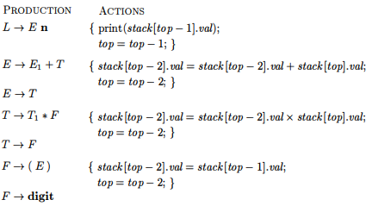
Parser-Stack Implementation of Postfix SDT’s
Let us rewrite the actions of the desk-calculator SDT so that they manipulate the parser stack explicitly. Such stack manipulation is usually done automatically by the parser.

Slide 40
Thank You

